Slide 1

HACKATHON 2025
FormCheck AI
Instant Sports Form Analysis
AI-powered coaching for every athlete. Upload your video, get instant biomechanical feedback.
Upload Video
AI Analysis
Get Feedback
5-10 seconds
Real-time
Instant results

Slide 2
The Challenge
Coaching is a Luxury
Amateur athletes are left behind in the pursuit of excellence
Prohibitive Costs
Generic Solutions
Private coaching sessions cost $50-150/hour, making professional guidance inaccessible to most amateur players and youth athletes.
YouTube tutorials offer one-size-fits-all advice without personalized analysis of individual biomechanics and specific form issues.
Bad Habits Form
No Feedback Loop
Without expert feedback, athletes develop incorrect techniques that become muscle memory, limiting potential and increasing injury risk.
Athletes practice blind without knowing what they're doing wrong or how to improve specific aspects of their technique.
"Every athlete deserves access to professional-level analysis, regardless of their budget or location."

Slide 3
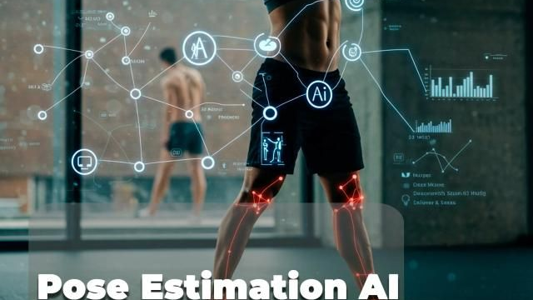
The Solution
Democratizing Sports Analysis
Professional-grade biomechanical analysis for every athlete
What is FormCheck AI?
A lightweight web app that brings professional-grade biomechanical analysis to every athlete. No expensive equipment. No hourly rates. Just instant, actionable feedback.
Key Features
Skeletal Tracking Overlay
AI-Powered Analysis
Visual representation of body positioning throughout the entire motion
Real-time skeletal tracking with 33 body landmarks
Precise Joint Angle Measurement
Calculates critical angles at key moments (elbow, knee, hip, ankle)
Supported Sports
Actionable Feedback
Specific suggestions like "elbow angle too tight on release"
Zero Hardware Required
Basketball
Football
Works with any smartphone video - no sensors or special equipment
Free throws
Penalty kicks

Slide 4
The Process
How It Works
Three simple steps to better form
1
2
3
Upload
Analyze
Feedback
User records and uploads a short video (5-10 seconds) of their free throw or penalty kick using any smartphone.
Our AI processes the video using pose estimation to track 33 body landmarks and calculate critical joint angles throughout the motion.
Receive instant visual overlay showing skeletal tracking with color-coded angle indicators and specific improvement suggestions.
Any device
MediaPipe Pose
Visual overlay
5-10 seconds
Sub-pixel accuracy
Actionable tips
Processing Time
<30s
33
8+
From upload to feedback in under 30 seconds
Total time
Landmarks
Joint angles

Slide 5

Technology
Built for Performance
Modern, efficient, and accessible technology stack
Python Backend
Robust video processing pipeline
Handles video ingestion, frame extraction, preprocessing, and coordinates the ML pipeline. Optimized for efficient memory usage and fast processing.
Tech Stack Overview
Modern tools for modern problems
OpenCV
System Architecture
Computer vision & visualization
Frontend: Lightweight web interface
Industry-standard library for video frame extraction, image preprocessing, and overlay rendering. Enables real-time skeletal visualization with smooth performance.
Backend: Python processing pipeline
AI: MediaPipe pose estimation
Output: Visual overlay + feedback
Google MediaPipe
Pose estimation model
Pre-trained model delivering 33-landmark human pose estimation with sub-pixel accuracy. Lightweight and optimized for real-time performance on standard hardware.
Lightweight
Fast
Accessible
Performance: Runs efficiently on standard hardware - no GPU required
Minimal resources
Real-time processing
Any device

Slide 6
Impact & Vision
Real-World Impact & Future Scope
Transforming sports training for millions
Immediate Impact
Future Roadmap
Democratize Access
1
Expand Sports Coverage
Bring professional-level analysis to millions of amateur athletes worldwide
Tennis serve, golf swing, baseball pitch, volleyball spike
Reduce Injury Risk
2
Pro Comparison
Correct improper form before it causes long-term damage
Compare user form against professional athletes
Accelerate Development
3
Progress Tracking
Faster skill improvement with data-driven feedback
Historical data and improvement analytics over time
Affordable Solution
4
Mobile App
Eliminate financial barriers to quality coaching
Native iOS and Android applications
5
Wearable Integration
Connect with fitness trackers for richer data
Target Users
Market Potential
Youth Athletes
Amateur Players
School Teams
2.5B+
$15B
85%
Amateur athletes
Sports tech market
Without coaching

Slide 7

THANK YOU
Questions?
Let's discuss how AI can transform sports training for everyone
Contact
GitHub
Website
team@formcheck.ai
github.com/formcheck-ai
formcheck.ai
Basketball
Football
AI-Powered

